Slide 1
Hadoop Intro
Jay Urbain, PhD
References follow

Slide 2
References (abbreviated)
Hadoop: The Definitive Guide, 4th Edition, Storage and Analysis at Internet Scale, Tom White, Publisher: O'Reilly Media, March 2015
http://shop.oreilly.com/product/0636920033448.do
http://hadoop.apache.org/
Cloudera
https://www.cloudera.com/documentation.html
https://www.cloudera.com/documentation/enterprise/latest/topics/quickstart.html
Hortonworks
https://docs.hortonworks.com/
MSOE CS4230 Distributed and Cloud Computing
http://jayurbain.com/msoe/cs4230/outline.html

Slide 3
Prerequisites
Install Virtual Box:
https://www.virtualbox.org/wiki/VirtualBox
Download Cloudera Quickstart VM:
https://www.cloudera.com/downloads.html?src=GoogleAdWords&gclid=CjwKEAjwsqjKBRDtwOSjs6GTgmASJACRbI3fv5t4JrzIWrgx3PIsoOpPlWXOiKDHNAPWgRsfS45qlxoCK2rw_wcB

Slide 4
Goals
Provide a basic overview of Hadoop Tools
Go into a little more depth with MapReduce and Hive
Expected background:
Programming language – Java, Python
Relational database – admin, query
Basic Linux commands

Slide 5
Hadoop
Two fundamental components plus projects
Open-source data storage:
HDFS
Processing API:
MapReduce
Other projects/libraries:
Hbase, Hive, Pig, Spark, Storm, etc.
Notes:
Hadoop – technology used to store and process large amounts of data

Slide 6
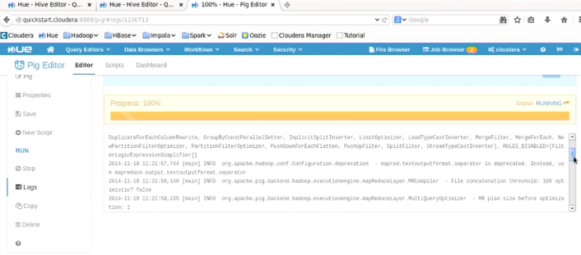
Hadoop – technology used to store and process large amounts of data

Slide 7
Understanding RDBMS Limits
Limits using RDBMS
Scalability – moving towards terabyte repositories
Performance – e.g., need realtime
Stream processing
Query-ability
Application of machine learning, iterative processing for optimizing coefficients
Hadoop ecosystem

Slide 8
Database Choices
File systems
Host file system
HDFS (Hadoop Distributed File System)
AWS S3
Databases
NoSQL
Key/value – Redis
Column store – Vertica
Document – MongoDB
RDBMS – MySQL, Postgres, Oracle, et.

Slide 9
Hadoop and HBase
Hadoop uses an alternative file system (HDFS)
Modeled after The Google File System paper:
http://xpgc.vicp.net/course/svt/TechDoc/storagepaper/gfs-sosp2003.pdf
Hbase (also Hive, BigTable, Dynamo, etc.)
NoSQL (non-relational) database
Wide column store – key, 1..n values
Wide column schema can vary
E.g., customer id, customer attribute values

Slide 10
CAP Theorem
Consistency
Support atomic transactions, ACID properties
Strong consistency
Availability
Uptime
Partitioning
Can split data across multiple machines
Scalability – partition data and processing across multiple machines
DB systems can meet 2 of 3 properties
RDBMS – ?
Hadoop - ?
Notes:
RDBMS – consistency, availability
Hadoop – availability, partitioning
Hadoop designed to run on commodity hardware – copies of data by default

Slide 11
CAP Theorem
Consistency
Support atomic transactions, ACID properties
Strong consistency
Availability
Uptime
Partitioning
Can split data across multiple machines
Scalability – partition data and processing across multiple machines
DB systems can meet 2 of 3 properties
RDBMS – consistency, availability
Hadoop – availability, partitioning
Notes:
RDBMS – consistency, availability
Hadoop – availability, partitioning
Hadoop designed to run on comodity hardware – copies of data by default

Slide 12
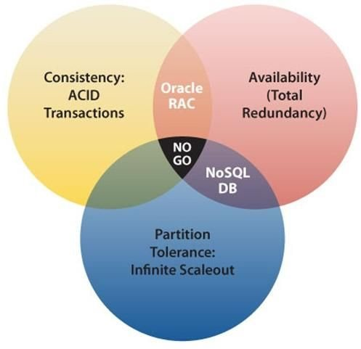
CAP Theorem
Interpretation and implementations of CAP theorem vary, but most of the NoSQL database systems favor partition tolerance and availability over strong consistency.

Slide 13
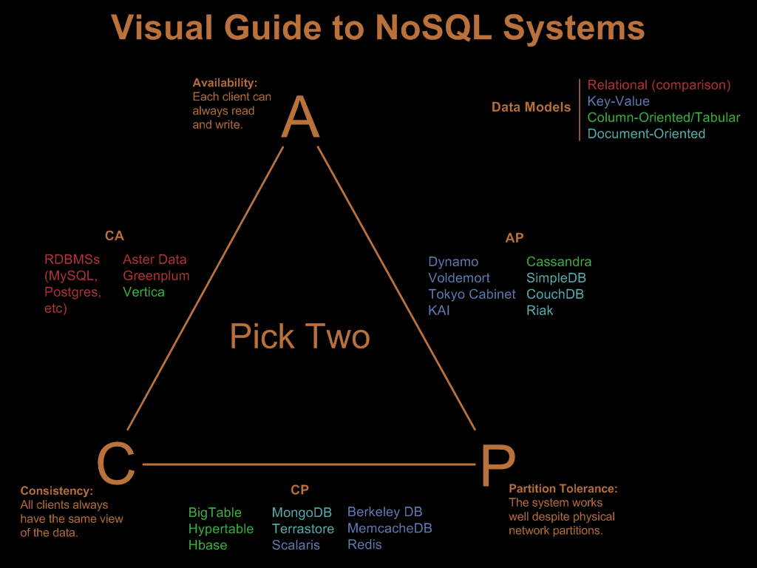

Slide 14
Hadoop CAP Properties
Scalability (partition tolerance)
Commodity hardware for data storage
Availability
3 copies of data by default
partition tolerance
Commodity hardware for distributed processing
Originally designed by Google to index the Internet!
Top users: Facebook, Yahoo, many others

Slide 15
Data for Hadoop
Transactional data
Not a good fit for Hadoop
Need to maintain consistency
E.g., Healthcare: prescription, charge capture, financial transactions
Keep in RDBMS
Behavioral data – world of big data
Batch data, stream processing, iterative processing
E.g., Analyze transaction history, health records, sensor data, etc.

Slide 16
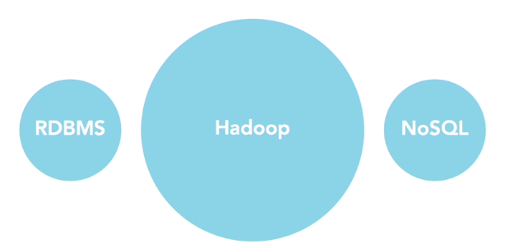
Changing Data Landscape
Think about different activities

Slide 17
Review
Hadoop is not a database. It is an alternative file system (HDFS) with a processing library.
True
False
Under which CAP Theory property(s) does a transaction fall?
Availability
Consistency
Partitioning
Scalability
What data is a good candidate for Hadoop?
Transactional
LOB
Relational
Behavioral

Slide 18
Hadoop Distributions
100% Open Source
Apache Hadoop, many versions, aggressive release cycle
Commercial – provide additional administrative tools, and applications
Hortonworks
Cloudera
MapR
Cloud
AWS
Can use Apache Hadoop on AWS with a particular version
Can use commercial version implemented on AWS cloud, e.g., MapR on AWS.
Windows Azure HDInsight

Slide 19
Why Use Hadoop
If you have behavioral data versus transactional data, Hadoop can be a better fit: cheaper, faster, better
Cheaper
Scales to petabytes or more
Faster
Parallel data processing
Better
Suited for particular types of ‘Big Data’

Slide 20
Hadoop Business Problems
Use behavioral data to make better decisions:
Sensor data modeling
Identify predictive patterns in large heterogeneous sensor data
Location, activity, equipment, environmental
Risk modeling
Need to make best decisions from as much credit data as possible
Optimize healthcare best practices
Credit card activity
Use machine learning to identify patterns in transaction data
Customer churn
Expensive to acquire new customer.
Recommendation engine
Netflix, Amazon from preferences
Search
Indexing, construct distributed inverted index
Machine learning
Fit complex, high-dimensional, non-linear models to massive data sets
Add targeting
Classic behavior modeling from click-through data
Data transformation
Patient de-identification, NLP

Slide 21
Organizations often combine transactional data with behavioral data to make better decisions
Facebook
Yahoo!
Hortonworks was started from ex-Yahoo’ers
Amazon
eBay
American Airlines
NY Times
Federal Reserve Board
IBM
Orbitz
Etc.

Slide 22
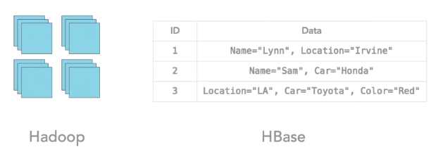
Hadoop versus HBase
HDFS file system is designed for very large blocks 64/128M chunks versus 8K blocks in traditional file system.
Written in Java, programming API
HBase wide column store, schema on read. Easier for non-programmers.
HBase stores table in HDFS.

Slide 23
Hadoop Job Categories
Hadoop Developer – our focus
Hadoop Administrator
Hadoop Architect
Note: Debugging is multi-disciplinary
Problems due to cluster architecture, available resources can cause programs to fail
Often need to change your program to optimize use of existing resources

Slide 24
Review
In Hadoop the processing API is _____
MapReduce
HDFS
Hbase
Hive
Programmers can natively process large files using ______, but Analysts can use ______ to query data from large files
MapReduce; Hbase
Hbase; MapReduce
Hbase; HDFS
HDFS; MapReduce

Slide 25
Java Virtual Machines
JVM – execute Java bytecode in an executable program.
Hadoop processes run in separate JVM’s.
Traditional data processing programs run multiple processes (threads) in the same JVM, and can share state.
By running processes on separate JVM’s they can not share state.
JVM process for Version 2.0 MapReduce (MRv2) has been changed from Version 1.0: MRv2 add the YARN resource management layer.

Slide 26
Hadoop File System - HDFS
HDFS
Distributed (triple replicated, files partitioned on 3-nodes)
pseudo-distributed modes (single node)
Regular file system
Standalone
Cloud file system
AWS S3; Azure Blob

Slide 27
Running Hadoop: Files and JVMs
Single node
Local file system
Single JVM
Pseudo-distributed
Uses HDFS
JVM daemons run processes

Slide 28
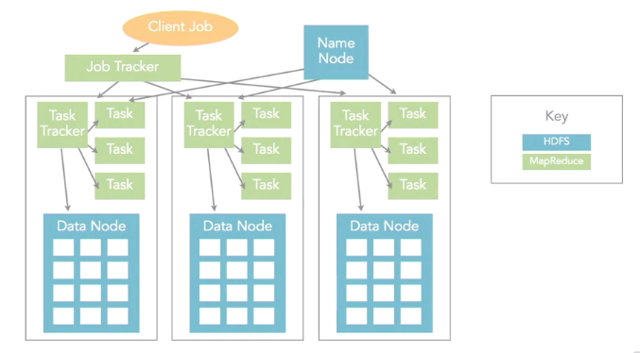
Fully Distributed Mode - 3 physical servers - daemons run and tracking tasks, manage chunk storage - Job Tracker and Name Node (chunk/data mgmt.) runs on a separate server(s) server - All separate JVM’s

Slide 29
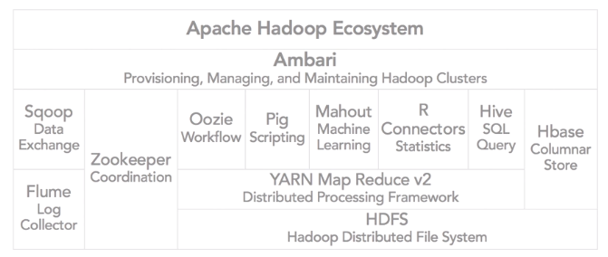
Hadoop Cluster Components “Ecosystem”
YARN – Yet Another Resource Negotiator
Hive – HQL - SQL like query language
Pig – scripting language for ETL
Mahout – machine learning library
Oozie - workflow, coordination of jobs
Zookeeper – coordinates groups of jobs
Sqoop - data exchange between RDBMS and Hadoop
Flume – log collector
Ambari – provisioning, managing and monitoring Hadoop Clusters

Slide 30
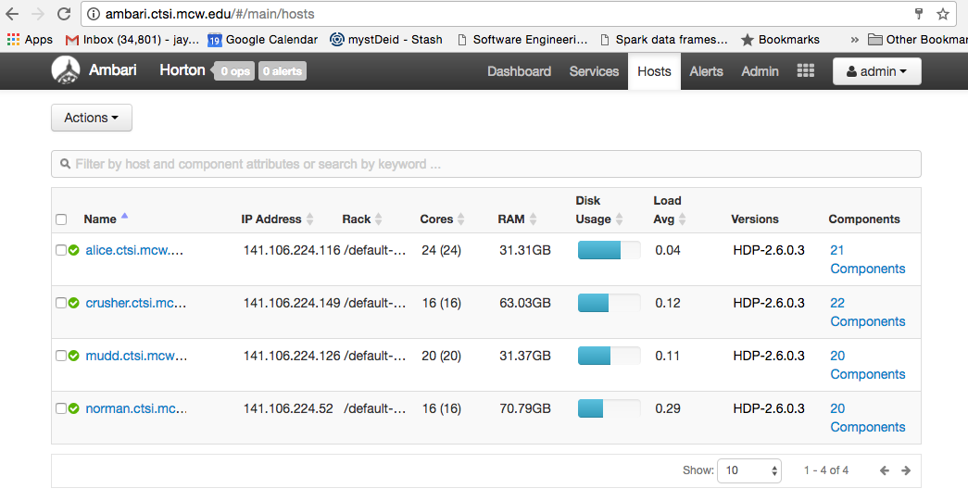
Ambari
http://ambari.ctsi.mcw.edu/#/login

Slide 31
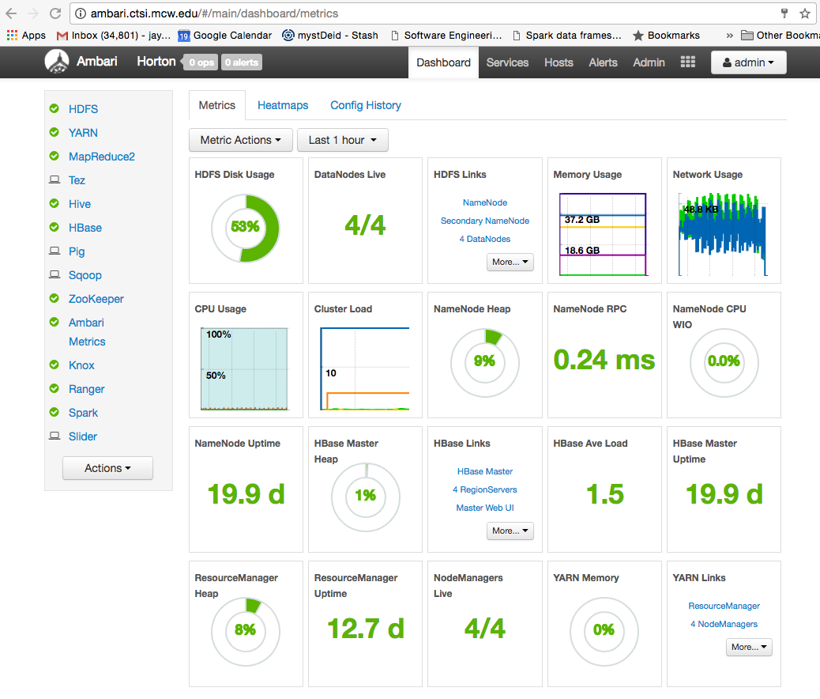
Ambari

Slide 32
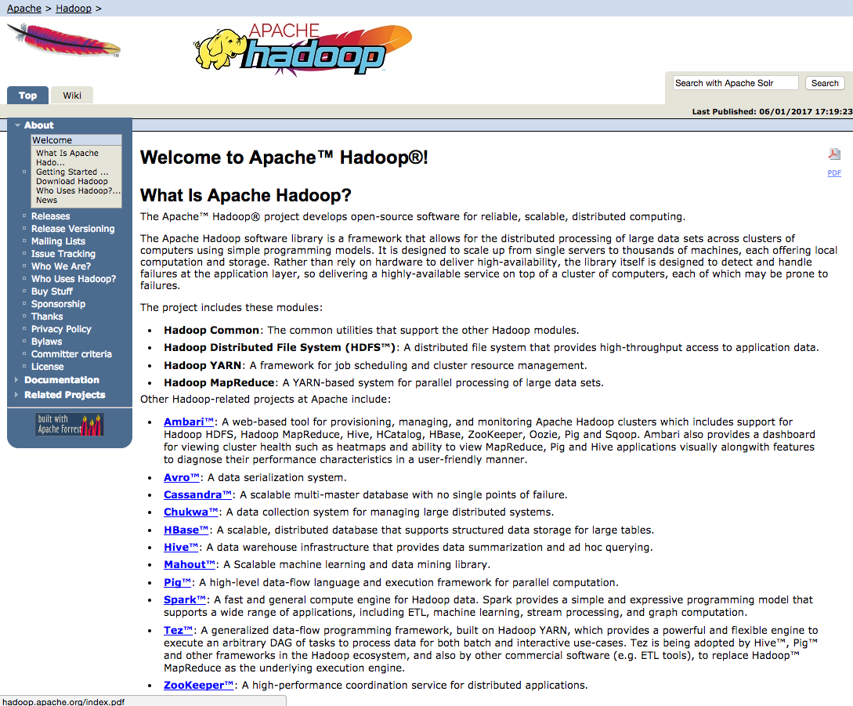
http://hadop.apache.org
Setting up binaries and setting up plain vanilla Hadoop is difficult.
Go with a distribution from Cloudera or Hortonworks, or cloud.
Notes:
Setting up binaries and setting up plain vanilla Hadoop is difficult.
Yellow Elephant, Doug Cutting’s young son had a play yellow elephant.

Slide 33
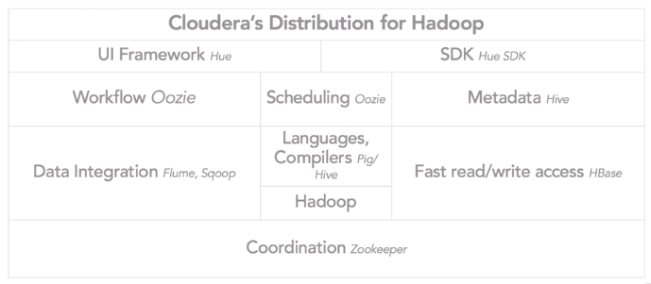
Cloudera Distribution

Slide 34
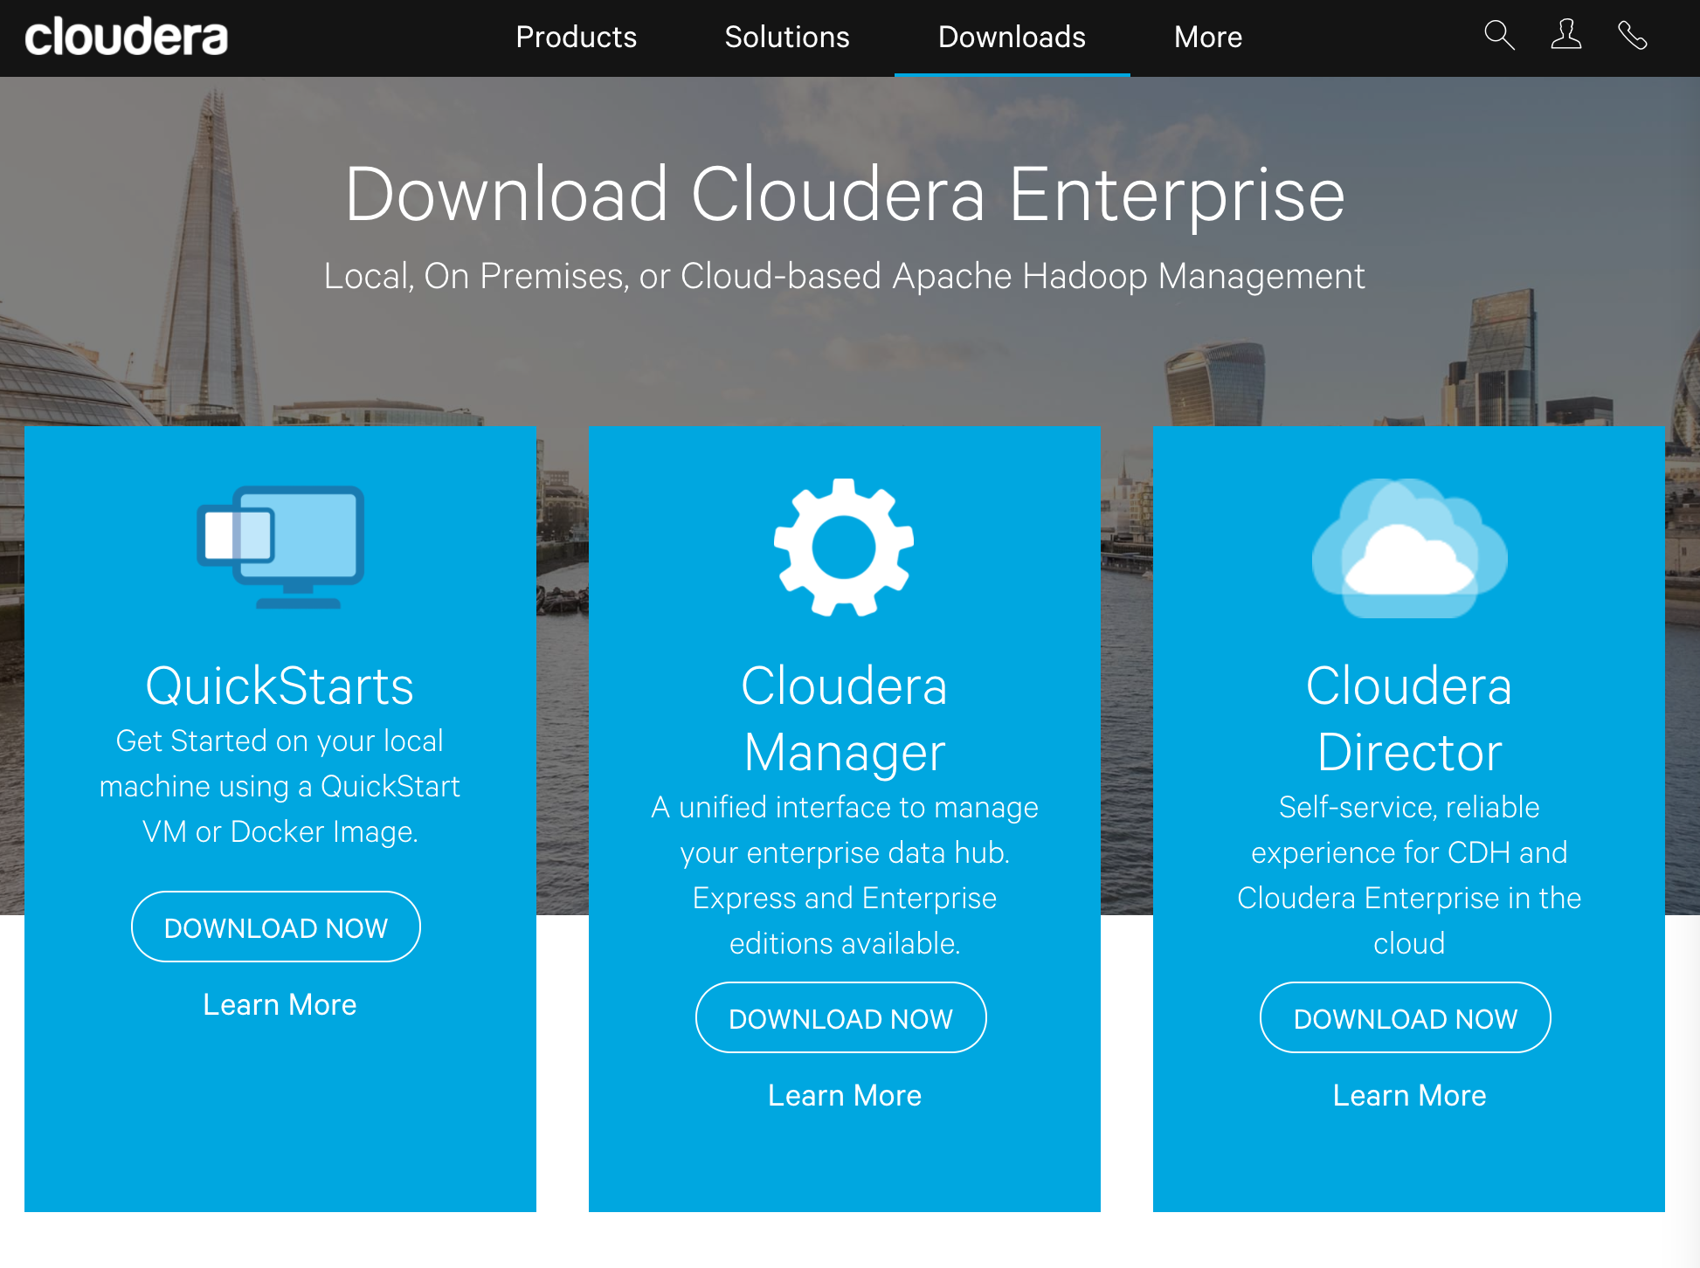
https://www.cloudera.com

Slide 35
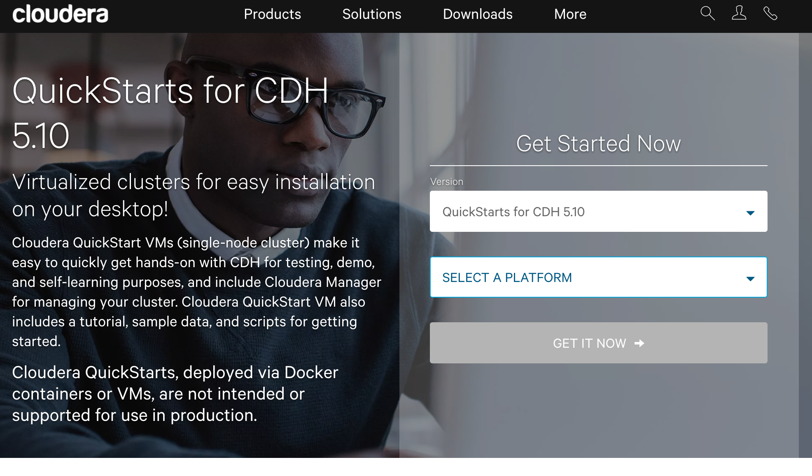
Downloads: Cloudera Quick Start

Slide 36
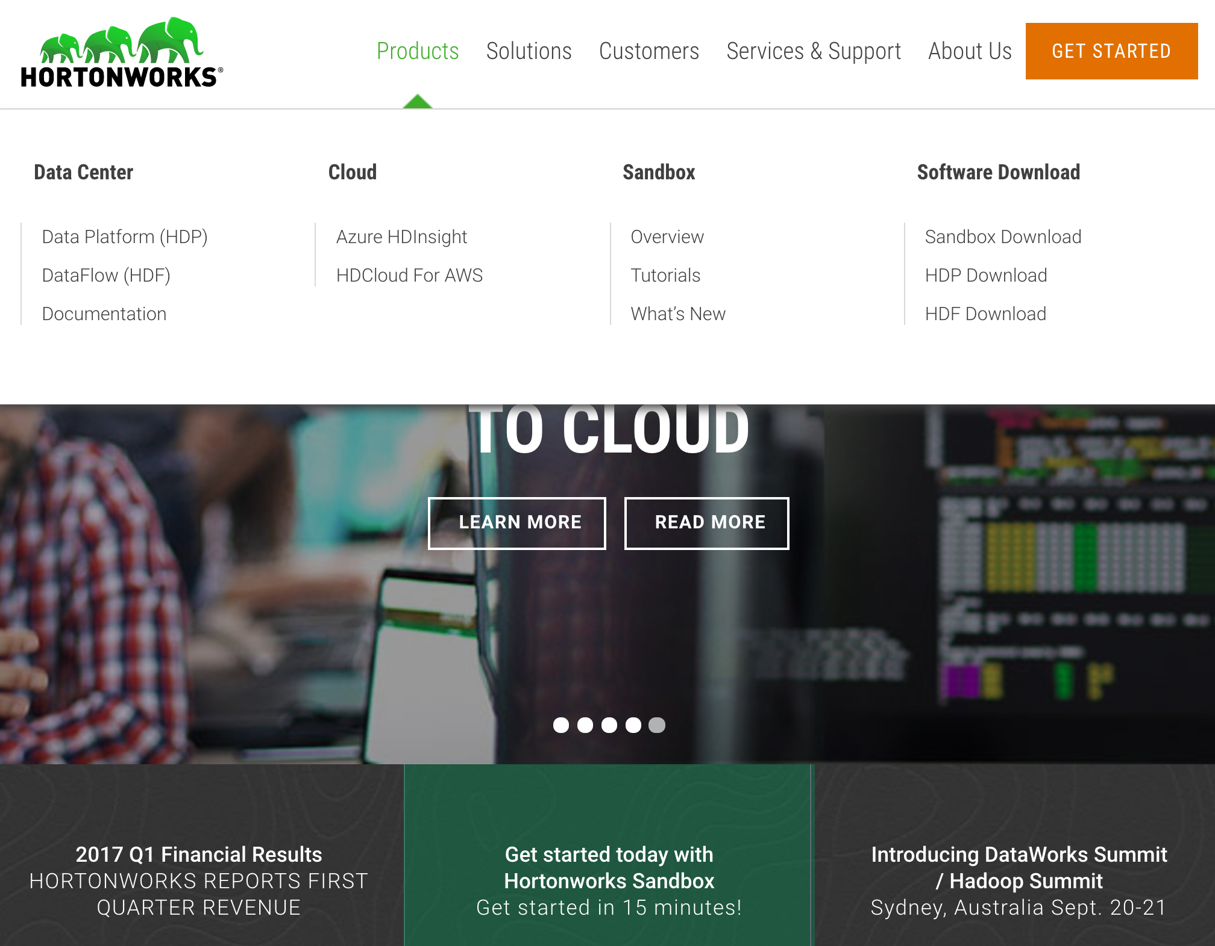
https://hortonworks.com/
Notes:
Have both Linux and Windows local installation
Can use sandbox or web hosted version

Slide 37

https://mapr.com/
Notes:
MapR changed the file system that they work wity. Use NoSQL file system. Drill, Spark, and Search

Slide 38
Selecting Vendors
Review vendor resources
Important to see which projects vendors are supporting, e.g., Tez for interactive queries on Hadoop in addition to batch-based queries.
Applications targeted and provided by vendors
Very competitive, no right/wrong answer

Slide 39
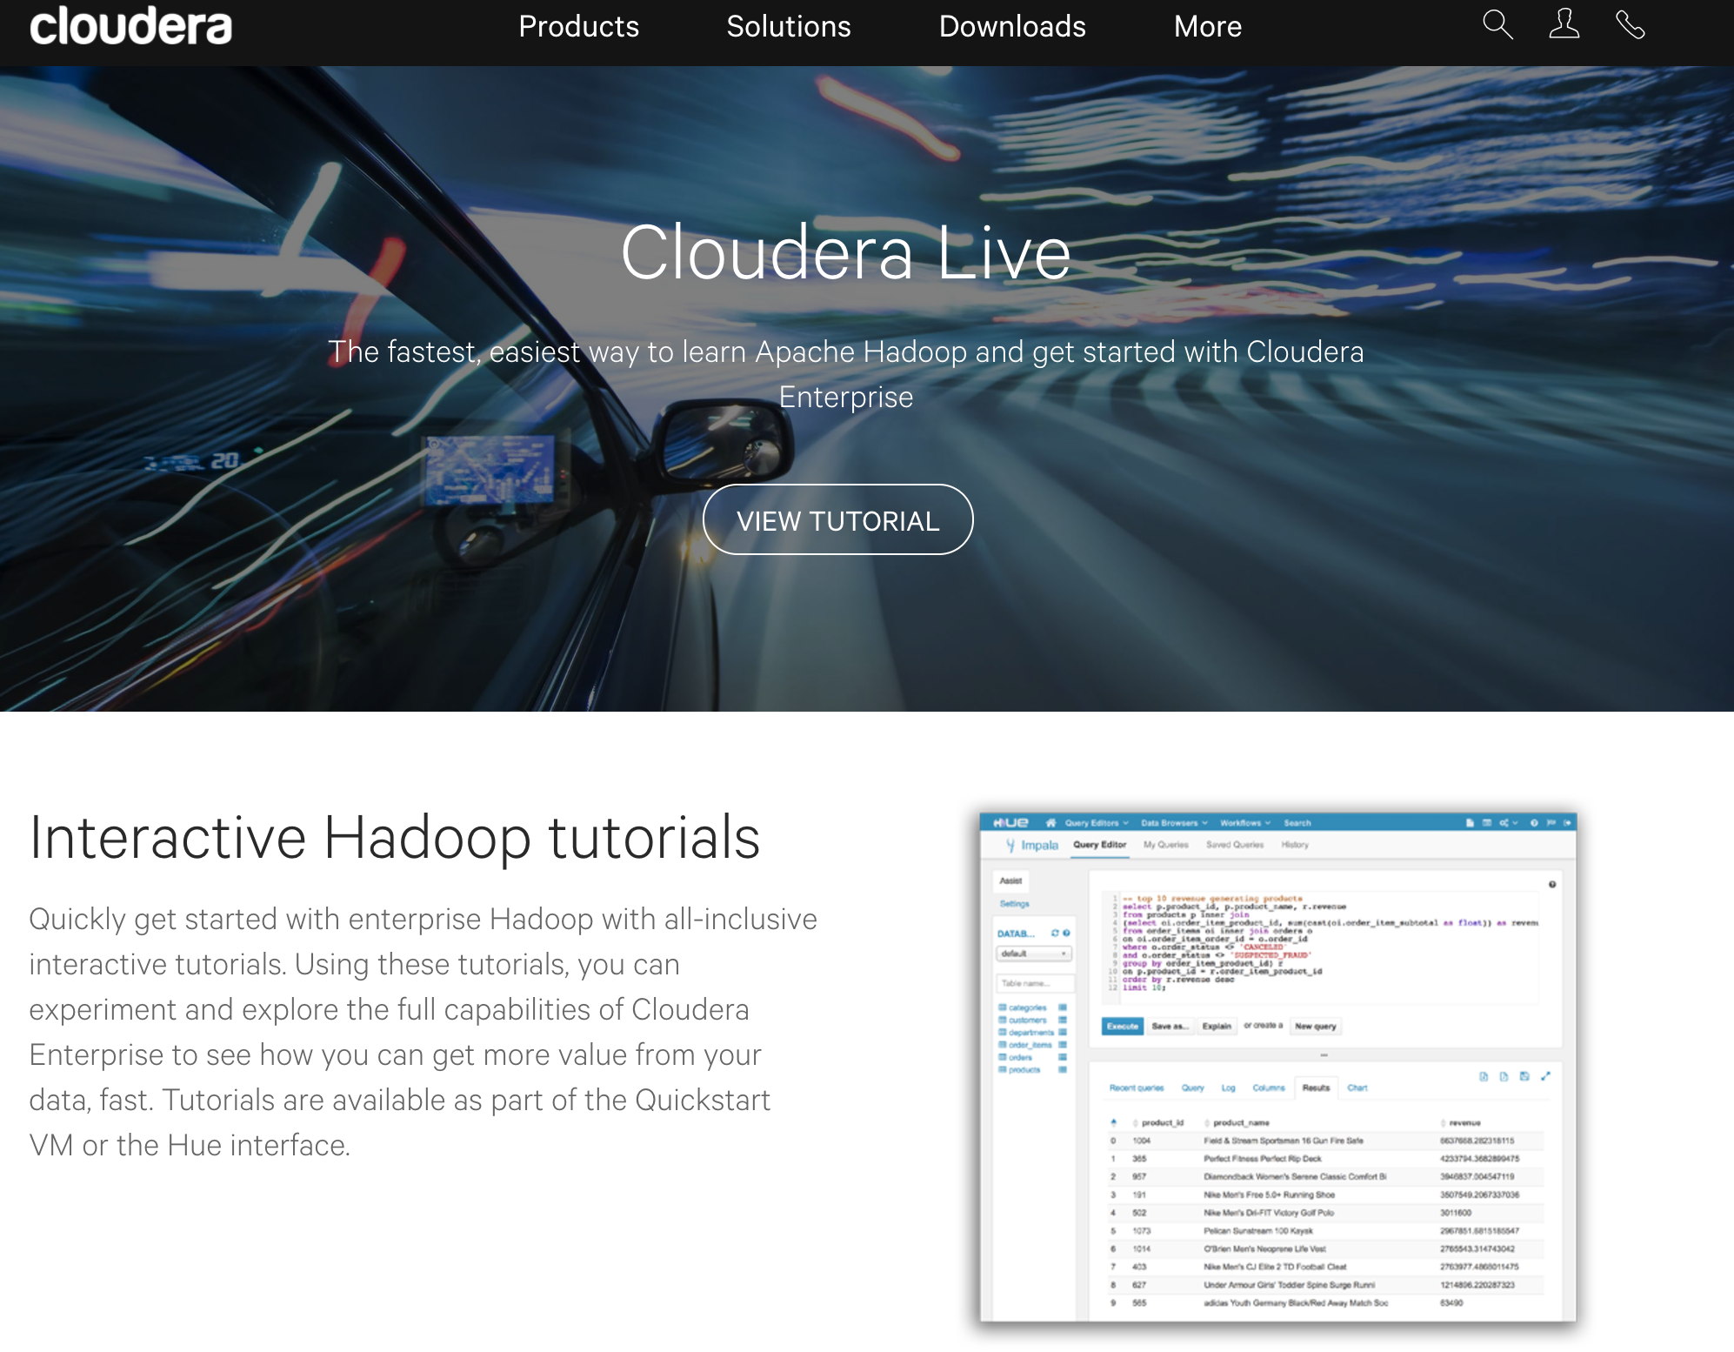
https://www.cloudera.com/get-started/cloudera-live.html Note: scroll down and select Online HUE Tutorial

Slide 40
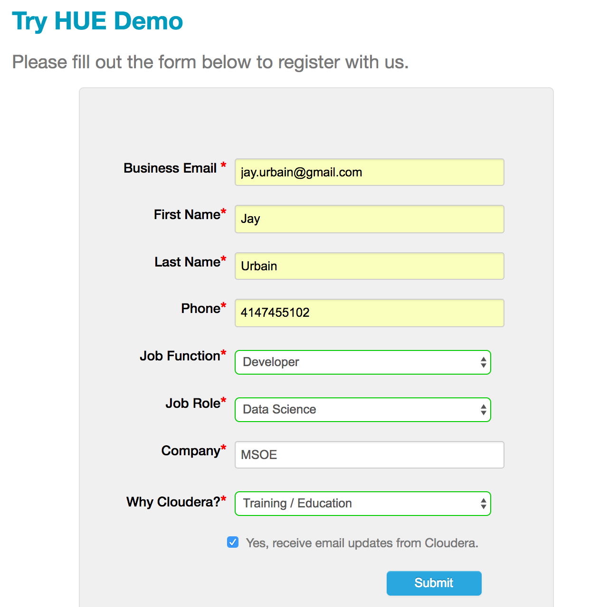
Cloudera Live http://go.cloudera.com/hue-demo

Slide 41
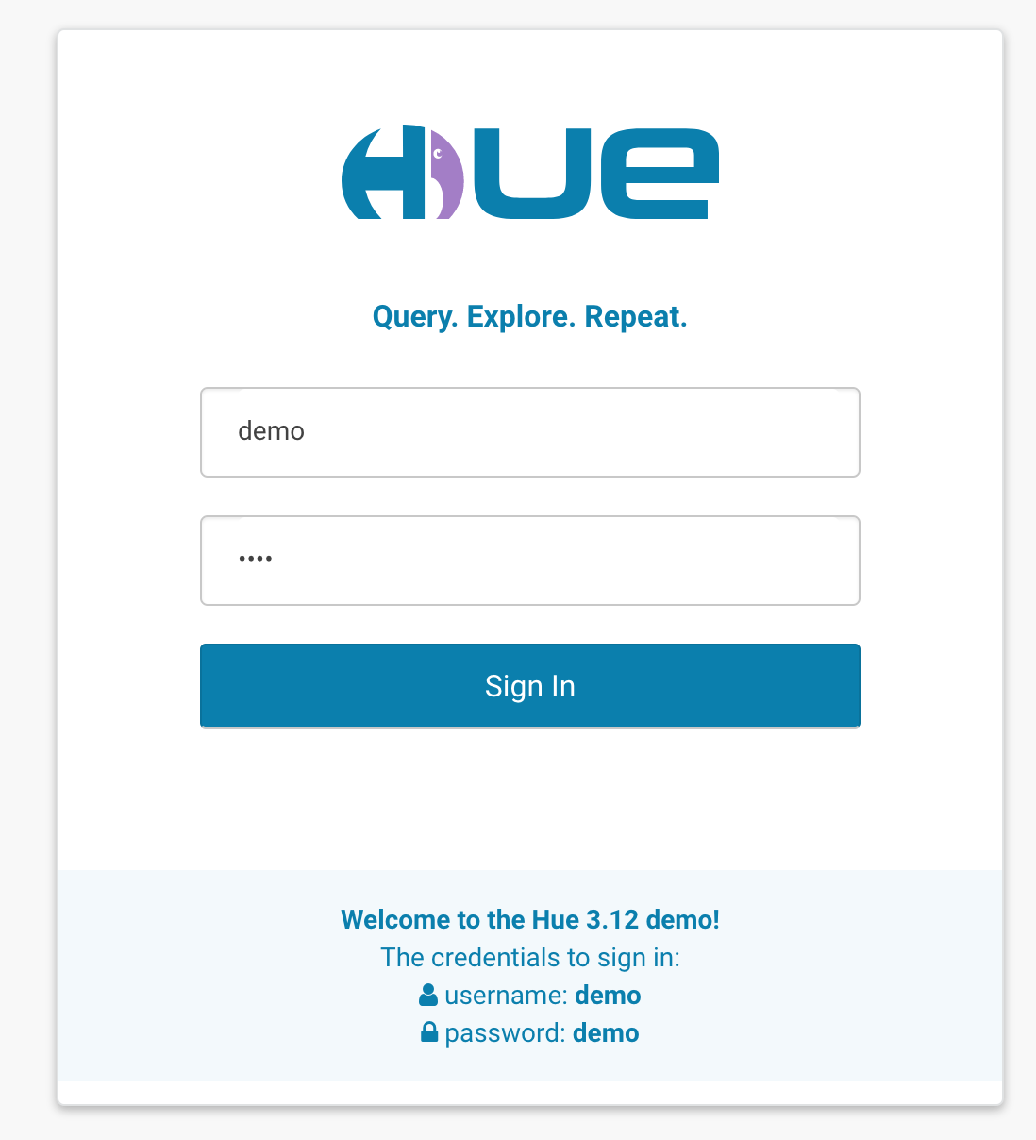

Slide 42
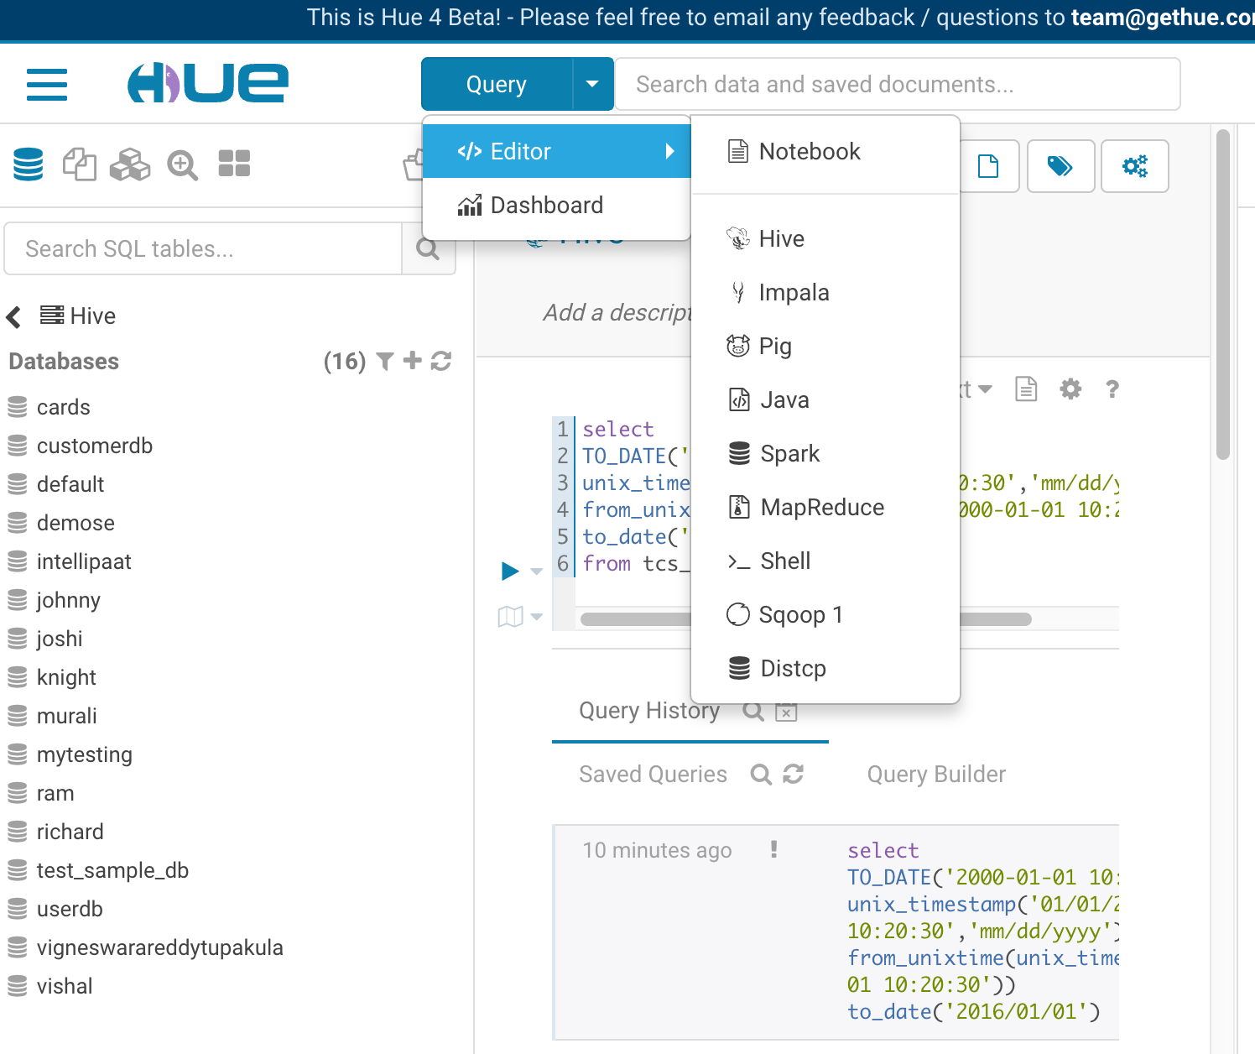

Slide 43
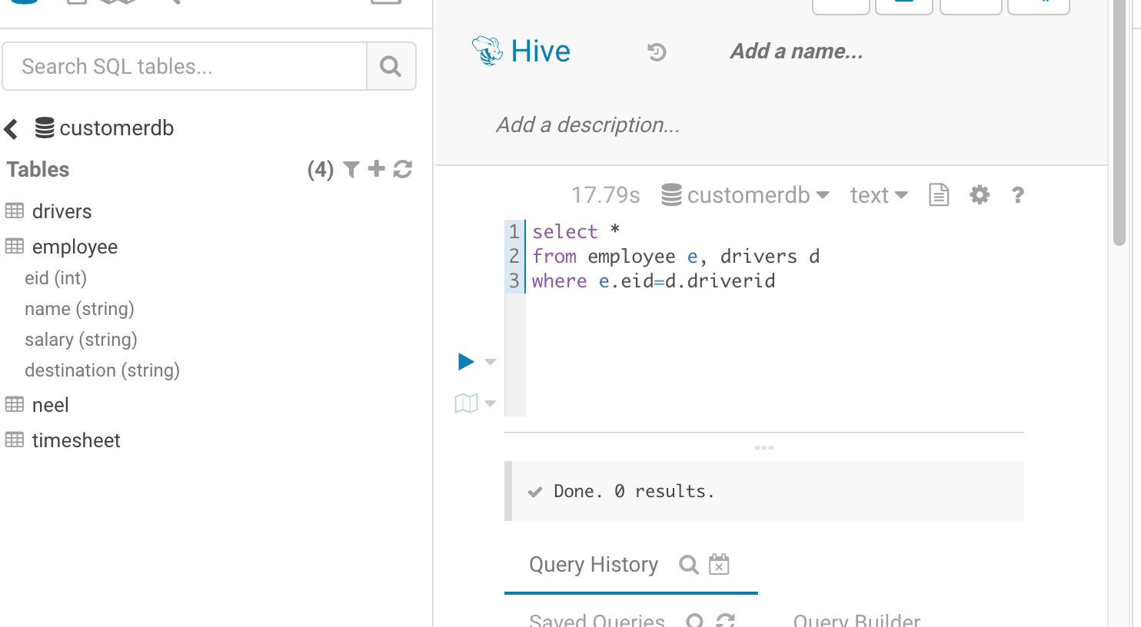
Hive Query

Slide 44
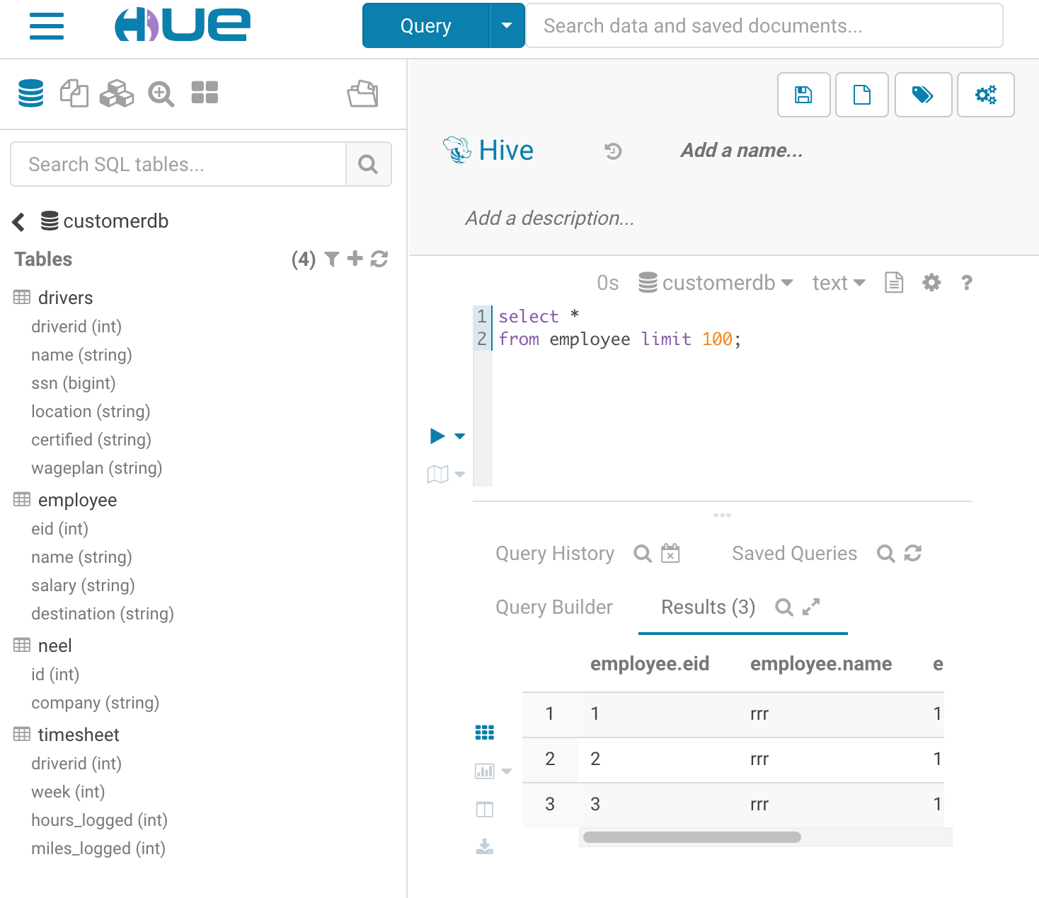
Hive - bstraction over map reduce,
You do not get back an immediate result.
Broken down into a series of Map Jobs and Reduce jobs.
Runs in parallel across nodes in Hadoop cluster
Notes:
Abstraction over map reduce,
You do not get back an immediate result.
Broken down into a series of Map Jobs and Reduce jobs.
Runs in parallel across nodes in Hadoop cluster

Slide 45
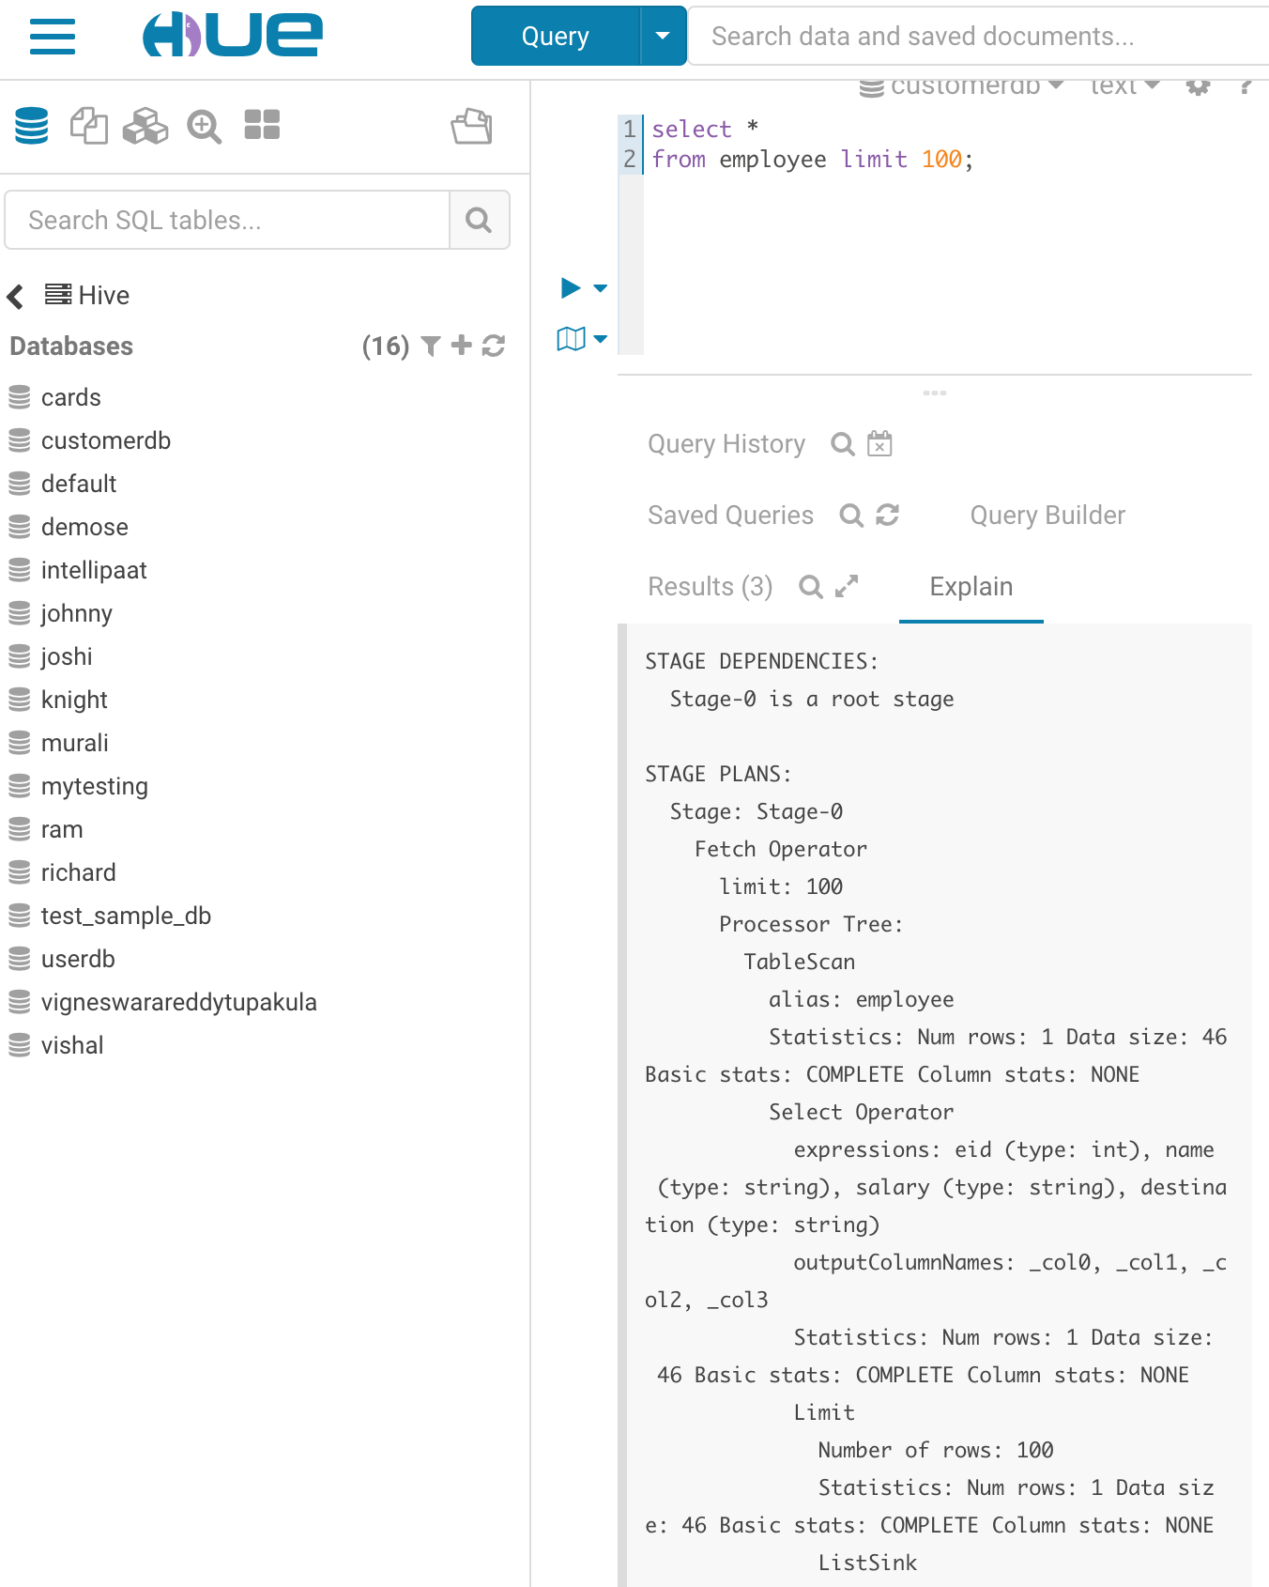

Slide 46
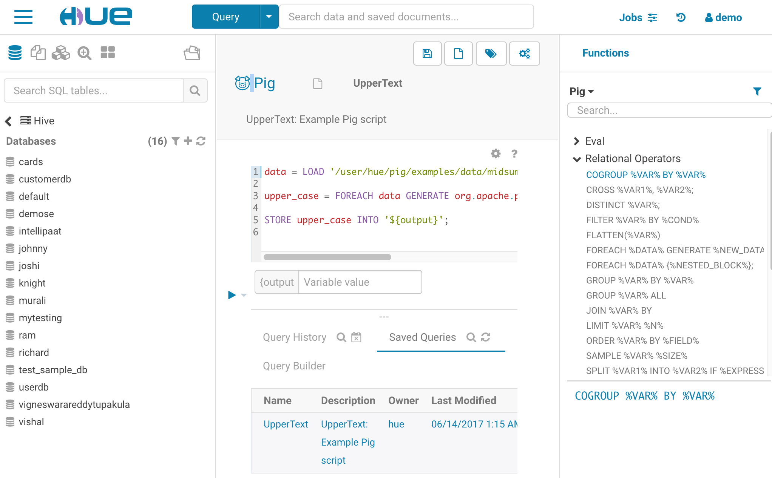
Pig Query for ETL

Slide 47
Hadoop Versions and History
Relatively new ecosystem - ~2007
Major stable releases
1.0 2011
2.2 2013 – YARN/MapReduce 2.0
2.4 2014 – Enterprise features, auto-failover
2.7.3 2016 – current
3.0 2017 - alpha
Decide if you want to work on a Cloud – clusters of VM’s.
EMR – AWS
HDInsight - Azure

Slide 48
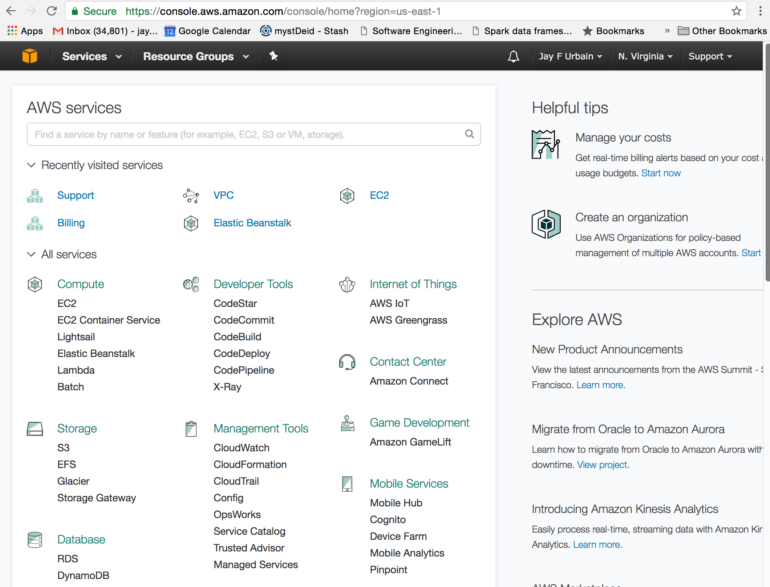
EMR – AWS https://aws.amazon.com

Slide 49
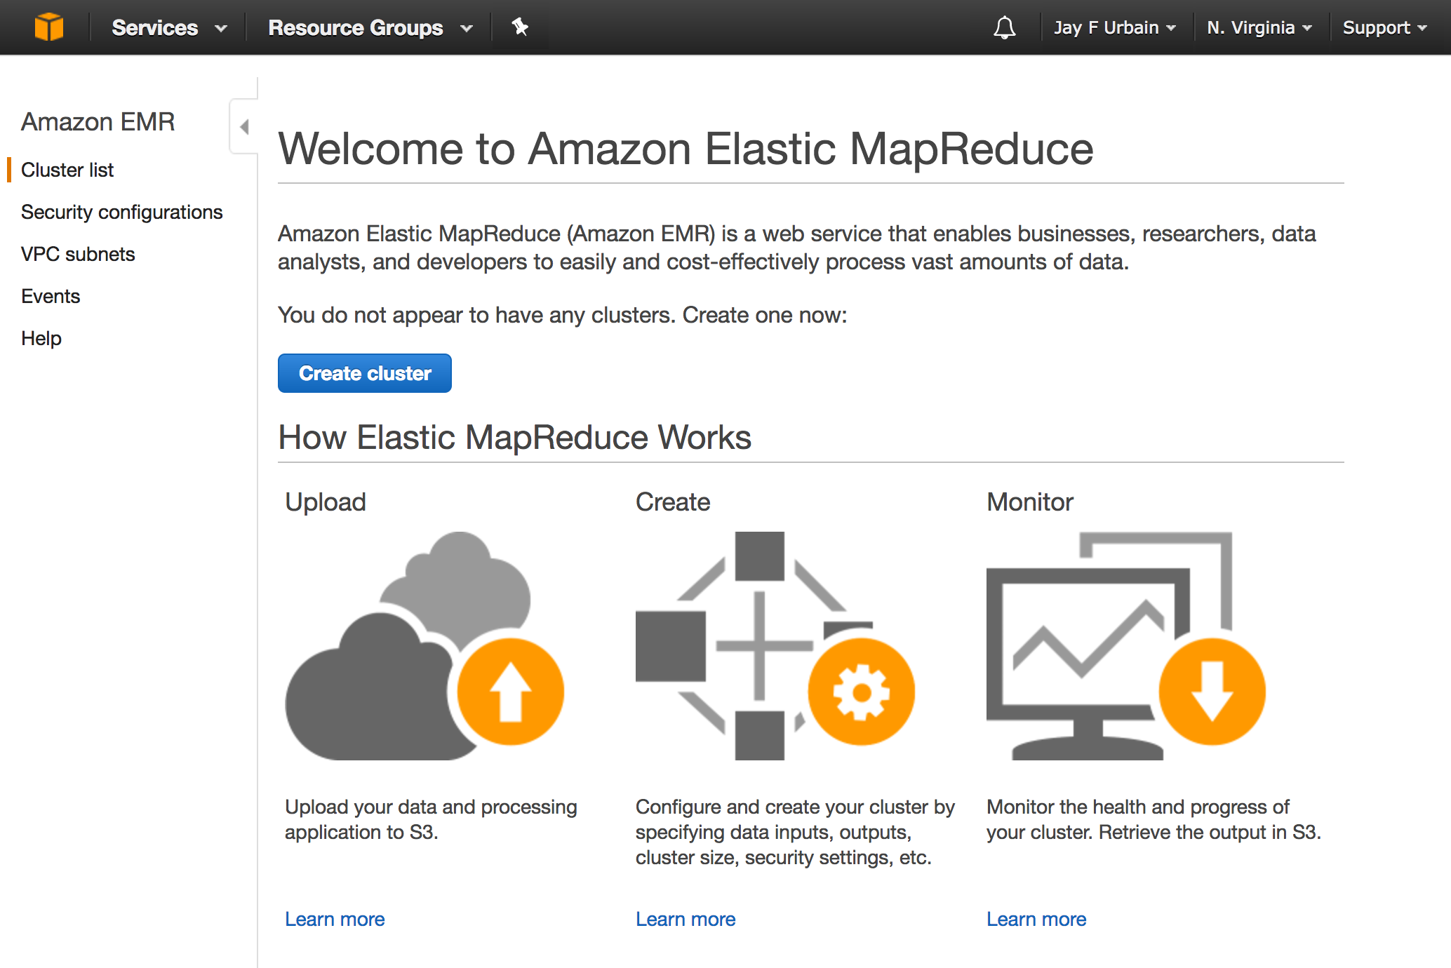
Can run directly out of S3 file system, or copy data from S3 to HDFS. When you create a cluster, remember to shut it off
Notes:
Can run directly out of S3 file system, or copy data from S3 to HDFS

Slide 50
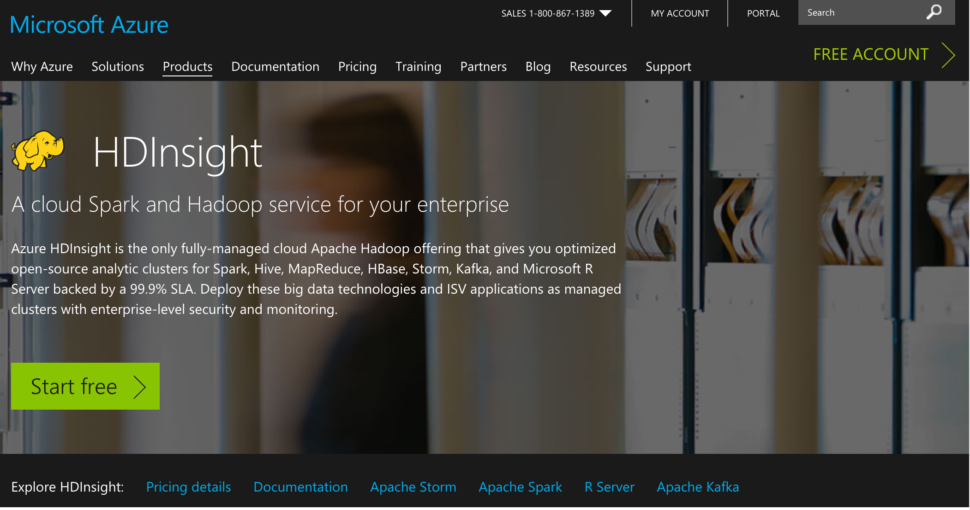
https://azure.microsoft.com/en-us/services/hdinsight/ Note: Runs on windows not linux, still uses MapReduce, HDFS
Notes:
Runs on windows not linux
Sensor data analysis tutorial

Slide 51
Review
JVMs do not share state and the different Hadoop processes run in separate JVMs
True
False
If you deploy in ______ mode you’re going to use HDFS and the Java Daemons are going to run all the processes on a single machine.
Multi
Multi or single
Psuedo-distributed

Slide 52
Review
Which of the following components is for workflow and coordination of jobs?
Hbase
Pig
Hive
Oozie
Which of the following is a way to download Hadoop and start using it?
Get the open-source version from the main site, www.hadoop.apahe.org
Get a vendor distribution like Cloudera or Hortonworks
Run on Cloud like AWS or Azure
Cloudera live
All of these answers

Slide 53
Review
Apache Drill (open source version of Google’s Dremel stream processing) and Spark add-ons are part of _______
Hortonworks
MapR
Solr
Windows 10
Cloudera
When running a Hive query, results will comeback immediately since there is no abstraction layer between it and MapReduce
True
False

Slide 54
Review
What is Microsoft’s implementation of partially managed Hadoop clusters?
Elastic Map Reduce
AWS
HDInsight
MapReduce
Foresight
Understanding the type of activity you want to do and what types of library you want to work with is important when selecting a Hadoop ecosystem.
True
False

